Slide 1
Hospital Inventory Management System
Team Members
Dinesh Balasubramanian - 002183348
Ronak Patil - 001007035
Liu Liu - 00153334
Sharmadha Parthiban - 002100759
Viraj Patel - 001001048

Slide 2
OBJECTIVE
FEATURES
Faster, digitized and semi-automated stock counting, ordering, and rotation of drugs.
Inventory updated after every transaction for drugs.
Allows customers to view available drugs and place orders.
Database will also include records on patients, doctors and other hospital staffs.
Creating a manageable database that generates reports based on inventory utilization
The aim of this project is to design, develop and implement a digitized healthcare inventory
considering the ongoing global pandemic situation

Slide 3
DESIGN FLOW
1. The patient gets a prescription from the doctor
3. Pharmacy process orders after receiving the order
2. Hospital assigns the order to partner pharmacies according to their medicine stocking
4. After the order is completed, the pharmacy updates the inventory and replenishes inventory

Slide 4
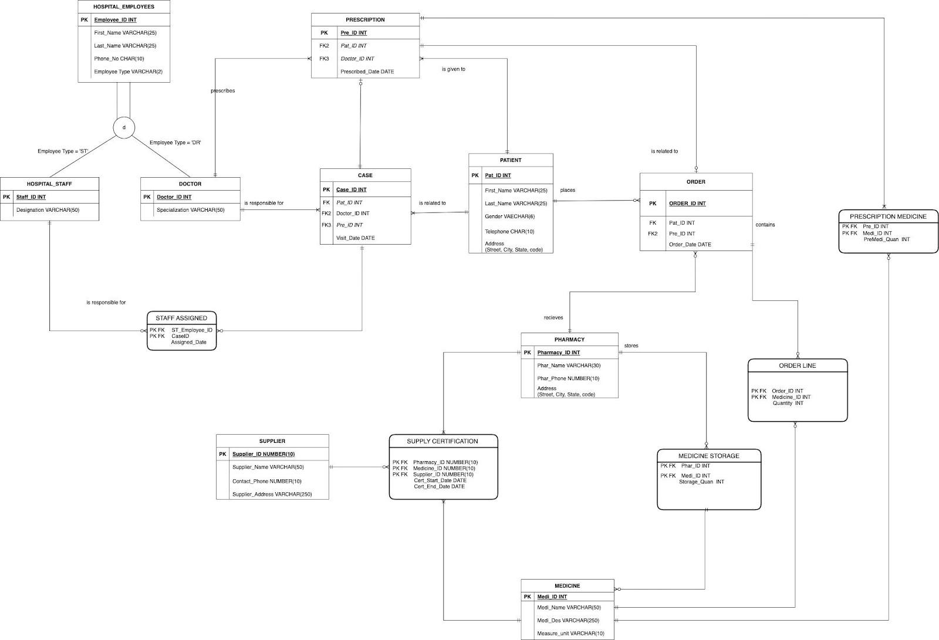
ENTITY RELATIONSHIP DIAGRAM

Slide 5
USECASES
USECASE 1 : TRACKING OF THE ORDERED SUPPLIES
Stored procedure is created to track the ordered supplies, thus allowing to keep track of the items availability
USECASE 2 : CERTIFICATION EXPIRATION
Created stored procedure to check for the expiration of the supplier certification thus preventing the unauthorized sales of drugs
USECASE 3 : TOTAL MEDICINE COUNT AS PER MEDICINE ID ACROSS ALL PHARMACIES
User defined function is created to retrieve the total medicine count across all pharmacies, thus enabling the management to get an integrated count of the available medicines
USECASE 4 : PRESCRIBED MEDICINE COUNT
View is for the count of different types of medicines prescribed by the doctor is created, thus enabling the hospital management to have an overview on the difference in the sales of most and least prescribed medicines for stocking them in prior

Slide 6
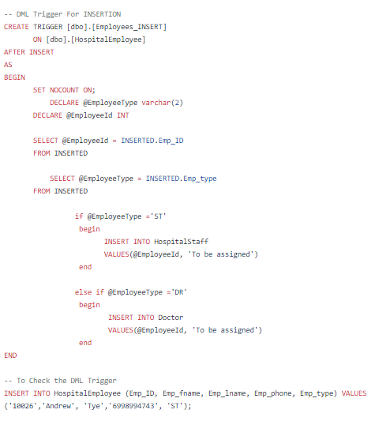
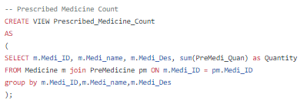
SAMPLE DDLS
TRIGGER FOR INSERTION
VIEW FOR PRESCRIBED MEDICINE COUNT

Slide 7
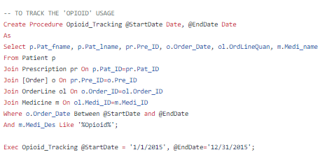
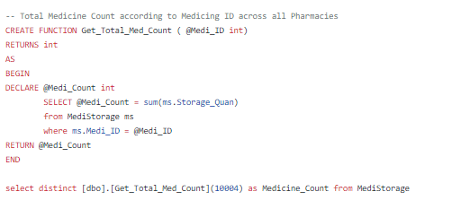
SAMPLE DDL
STORED PROCEDURE FOR TRACKING ORDERS
USER DEFINED FUNCTION TO GET THE MEDICINES ACROSS ALL PHARMACIES

Slide 8
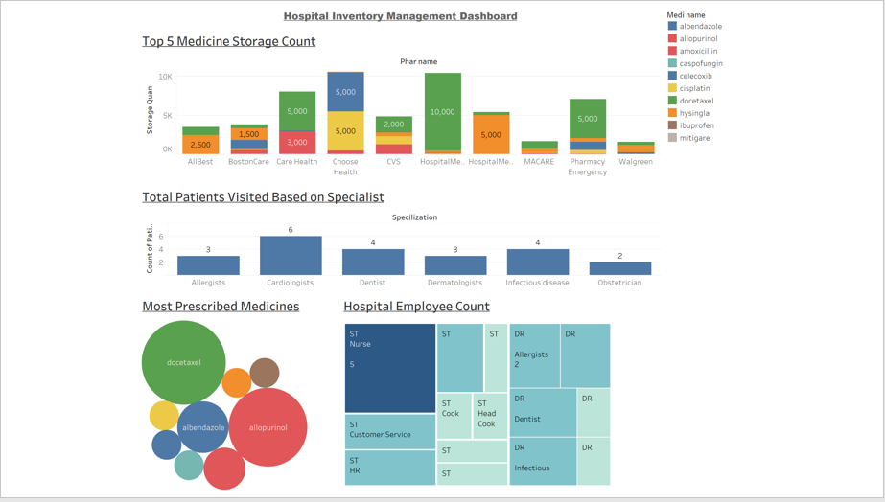
TABLEAU DASHBOARD

